Slide 1




Don’t Yank My Chain:
Auditable NF Service Chaining
Guyue (Grace) Liu, Hugo Sadok, Anne Kohlbrenner, Bryan Parno, Vyas Sekar, Justine Sherry
NSDI 2021

Slide 2



Network Function Virtualization (NFV)
VM
VM
NFV
Specialized Appliances
Commodity Server

Slide 3
Academia Efforts To Promote NFV
ClickOS [NSDI’14]
Flowtags
NetBricks [OSDI’16]
OpenBox
NFP [SIGCOMM’17]
mOS
Metron [NSDI’18]
Microboxes
Vigor [SOSP’19]
FlowBlaze
NetSMC [NSDI’20]
FTC
CoMb
Split/Merge
E2
[NSDI’12] | [NSDI’13] | [NSDI’14] | [SOSP’15] | [SIGCOMM’16] | [NSDI’17] | [SIGCOMM’18] | [NSDI’19] | [SIGCOMM’20]
Aplomb | SIMPLE | NetVM | FTMB | BUZZ | Stateless | SafeBricks | BOLT | Microscope
[SIGCOMM’12] | [SIGCOMM’13] | [NSDI’14] | [SIGCOMM’15] | [NSDI’16] | [NSDI’17] | [NSDI’18] | [NSDI’19] | [SIGCOMM’20]
2012 |  | 2014 |  | 2016 |  | 2018 |  | 2020

Slide 4







Cloud-based Network Functions
ClickOS [NSDI’14]
Flowtags
NetBricks [OSDI’16]
OpenBox
NFP [SIGCOMM’17]
mOS
Metron [NSDI’18]
Microboxes
Vigor [SOSP’19]
FlowBlaze
NetSMC [NSDI’20]
FTC
CoMb
Split/Merge
E2
[NSDI’12] | [NSDI’13] | [NSDI’14] | [SOSP’15] | [SIGCOMM’16] | [NSDI’17] | [SIGCOMM’18] | [NSDI’19] | [SIGCOMM’20]
Aplomb | SIMPLE | NetVM | FTMB | BUZZ | Stateless | SafeBricks | BOLT | Microscope
[SIGCOMM’12] | [SIGCOMM’13] | [NSDI’14] | [SIGCOMM’15] | [NSDI’16] | [NSDI’17] | [NSDI’18] | [NSDI’19] | [SIGCOMM’20]
2012 |  | 2014 |  | 2016 |  | 2018 |  | 2020
Load Balancer
Web App Firewall
VPN
Firewall
VPN

Slide 5

Enterprises Are Reluctant To Adopt NFV
NFV
Why?
Cannot meet government and industrial regulations requirements
Middleboxes must be deployed to protect sensitive data and systems
Administrators must periodically test that security infrastructure is running properly
Systems must provide logs of anomalies and past behavior

Slide 6






Traditional Auditing Approach
✓
Traditional Network Function (NF) chain

Slide 7







✓
No Existing Tools To Audit Virtualized NFs
Traditional Network Function (NF) chain
Modern virtualized NF chain
?
Ephemeral
Multi-service
VM
VM
VM
VM
Host 1
Host 2

Slide 8


AuditBox Contribution
Offer missing capabilities to audit NFV deployments
Provable, continuous assurance of correctness
Time-of-check-to-time-of-use vulnerabilities
Coarse, manual correctness checks

Slide 9
AuditBox Contribution
• Offer missing capabilities to audit NFV deployments
Provable, continuous assurance of correctness
Coarse, manual correctness checks
correctness?

Slide 10
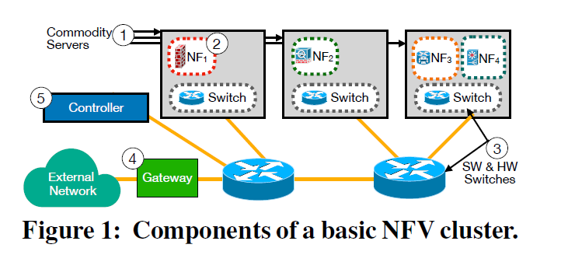
System model
Audit:
The correct and untampered NFs are running correctly
Packets traverse these NFs according to policy

Slide 11
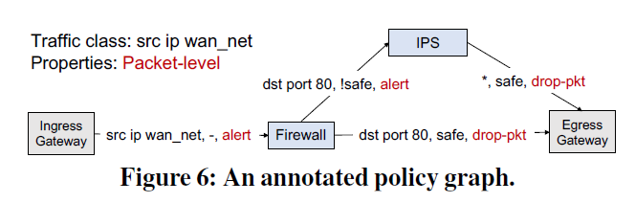
System model

Slide 12
What Does Correctness Mean?
Runtime Correctness = Network implements the intended NF forwarding policies
Packet correctness
Flow correctness
pkt
NF 1
NF 2
NF 3

Slide 13
Correctness
Packet correctness meets property 1
No injecting packets which were not sent by an end host
No modifying/corrupting packets between sender and receiver
Flow correctness meets property 1 &
Property 2: No drops
Property 3: Packets within a flow are not reordered between NFs
Property 4: No duplication
Notes:
No drops: Hence, no drops property is to state that packets in a given flow that do arrive at their own destination may only be accepted if all packets previously transmitted from
that flow to that destination have already arrived.

Slide 14
What Does Correctness Mean?
Runtime Correctness = Network implements the intended NF forwarding policies
Packet correctness
Flow correctness
pkt
NF 1
NF 2
NF 3
Offline Auditability = Must provide a tamper-proof ‘audit trail’

Slide 15
Limitations of Prior Work
Long history of work on verifying Internet paths (VRP)
[EPIC USENIX’20, OPT SIGCOMM’14, ICING CoNEXT’11]
Assumptions:
Immutable Packets
Pre-known Paths
Stateless Processing Nodes

Slide 16
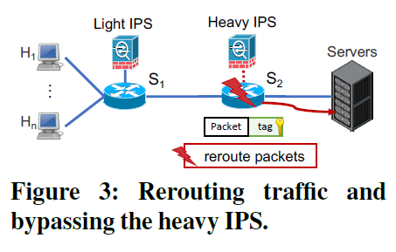
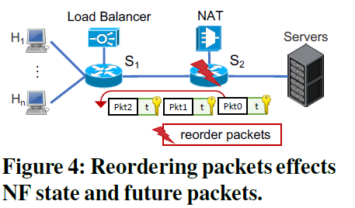
Assumptions Do Not Hold for NFV
Long history of work on verifying Internet paths
[EPIC USENIX’20, OPT SIGCOMM’14, ICING CoNEXT’11]
Assumptions:
Immutable Packets
Mutable Packets
Pre-known Paths
Dynamic Paths
VS
Stateless Processing Nodes
Stateful Processing Nodes
FIN packet is sent before the data packet that causes the load balancer discards the following data packets.

Slide 17
Assumptions Do Not Hold for NFV
Long history of work on verifying Internet paths
[EPIC USENIX’20, OPT SIGCOMM’14, ICING CoNEXT’11]
Assumptions:
Immutable Packets
Mutable Packets
Pre-know
Assumptions do not hold for NFV
ynamic Paths
^{n} VS ^{D}
Paths
Stateless Processing Nodes
Stateful Processing Nodes

Slide 18
Outline
Motivation
Our Insight
AuditBox Design
Evaluation

Slide 19




Our Observation
The complexity of auditing comes from NFs’ internal processing
NF 1
NF 2
NF 3
(e.g., switch, OS)

Slide 20




Our Insight
The complexity of auditing comes from NFs’ internal processing
NF 1
NF 2
NF 3
(e.g., switch, OS)
NF 1
NF 2
NF 3
Run NFs within Trusted Execution Environment (TEEs), and only audit actions between NFs over the untrusted network.

Slide 21

TEE: Trusted Execution Environment
Code and data: confidentiality and integrity
TEE

Slide 22
Our Insight
Prior Work: SafeBricks [NSDI’18], ShieldBox [SOSR’18],
LightBox [CCS’19], etc
Prior work focuses on securing individual NFs on a single server,
not auditing the entire service chain across servers
NF 1 NF 2 NF 3
Run NFs within Trusted Execution Environment (TEEs), and only audit actions between NFs over the untrusted network.

Slide 23





Threat Model
Control Plane
Controller
(trusted)
Policy
Secure Channels
Shim
Intel SGX Enclave (trusted)
NF
NF
Data Plane
...
Host 1
Host N
Rewrite, drop, inject, or reorder packets
Untrusted Network
(e.g., switches, routers)

Slide 24
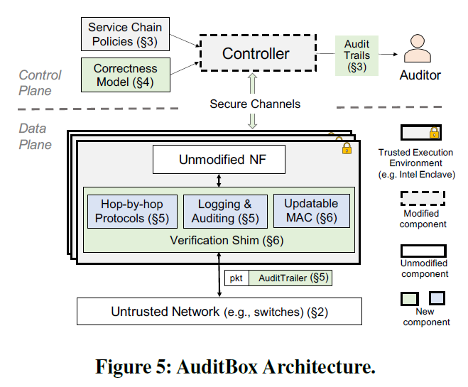
AuditBox
NF deployment and management

Slide 25

Design Overview
Control Plane
Controller
(trusted)
Audit Trails
Offline Auditability: Secret Logging
Policy
Administrator/ Auditor
Secure Channels
Intel SGX Enclave (trusted)
Trusted NFs:
Verification shim
NF
NF
Data Plane
...
Shim
Shim
Shim
Host 1
Host N
Runtime Correctness:
A hop-by-hop verification protocol
25
Untrusted Network
(e.g., switches, routers)

Slide 26





NF Hop-by-hop Verification Protocol
A shim in each enclave implements the protocol
Determines the correct next-hop NF according to a policy it received from the controller
Checks each incoming packet to verify that the packet has not been improperly
routed or modified
Logs any packets to local storage
Leverage transitive trust to verify packets and enforce policy
Check: validates the received packets
Process
Updates the AuditTrailer
Log
Enclave
Enclave
NF1
NF2
Shim
Shim
P
Host 1
P’
Host 2

Slide 27
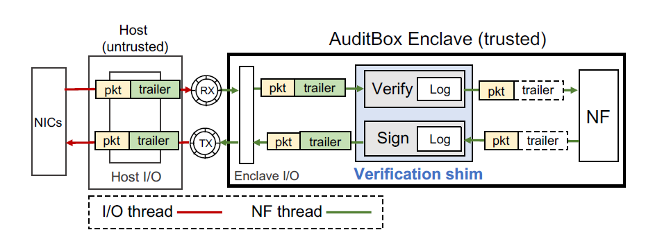
AuditBox

Slide 28
Correctness
Packet correctness meets property 1
No injecting packets
No modifying/corrupting packets between sender and receiver
Flow correctness meets property 1 &
Property 2: No drops
Property 3: Packets within a flow are not reordered between NFs
Property 4: No duplication
Notes:
No drops: Hence, no drops property is to state that packets in a given flow that do arrive at their own destination may only be accepted if all packets previously transmitted from
that flow to that destination have already arrived.

Slide 29
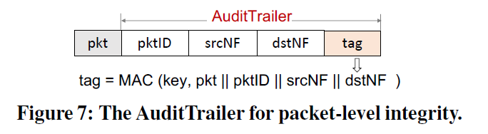
Packet correctness protocol
The packet does not been modified.
The packet is sent from the sender the receiver
Message authentication code: data integrity and authenticity

Slide 30
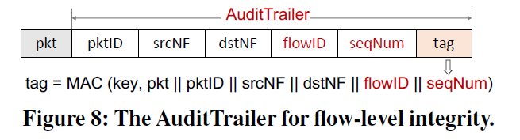
Flow correctness protocol
The packet does not been modified.
The packet is sent from the sender the receiver
No drops, no packet reordering, no duplication
seqNum: The sending NF maintains an incrementing per-flow counter for each flow
dstNF has a table showing the next expected seqNum for each flow

Slide 31

Optimization: Updatable GMAC
GMAC: Galois message authentication code
Reuse the first GMAC when computing the second GMAC to reduce overheads
Enclave NF1
_{Enclave} Enclave
_{NF1} NF2
_{Shim} Shim
P Host 1 _{P’} Host 2
Verify an incoming packet by checking the AuditTrailer
Update the AuditTrailer on an outgoing packet
1
Shim 2
Host 1
The second MAC’s cost is proportional to the number of modified data blocks.

Slide 32
Outline
Motivation
Our Insight
AuditBox Design
Evaluation

Slide 33
Evaluation
Proofs: We provide security proofs that AuditBox can achieve both runtime correctness and offline auditability
Functionality Evaluation: AuditBox correctly detects a broad class of policy violations
Performance Evaluation: AuditBox enables auditing for unmodified NFs with low overhead

Slide 34
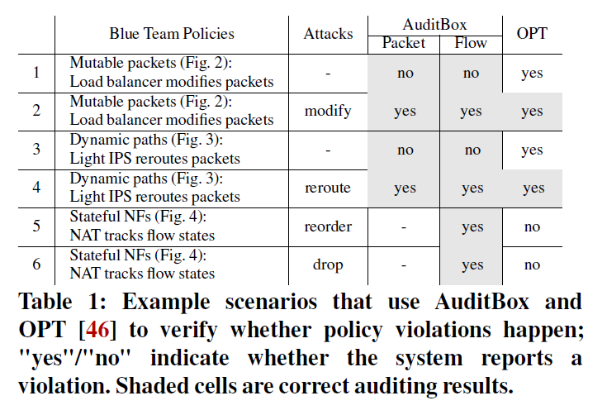
Functionality Evaluation

Slide 35
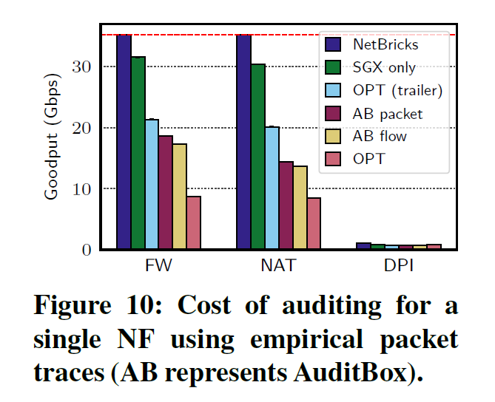
Evaluation: a single NF goodput
AuditBox achieves up to two times higher goodput than the strawman OPT due to our reduced packet overhead (24B for AB packet, 32B for AB flow, 84B for OPT)
OPT(trailer) achieves a higher throughput than AuditBox, which is expected as it requires fewer MAC computations
Notes:
Application level throughput, the number of useful information bits

Slide 36
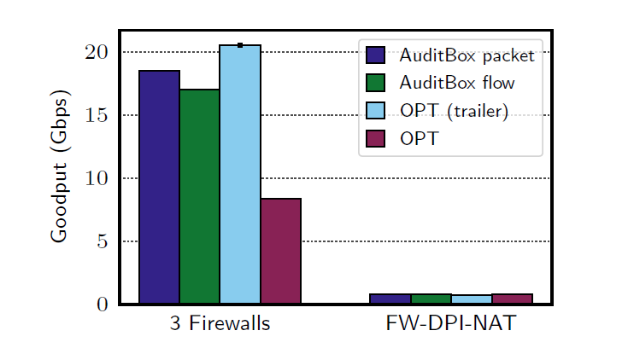
Evaluation: NF Chain Goodput
3 firewalls: AuditBox has 67% better goodput than OPT.
FW-DPI-NAT: the entire chain is bottlenecked by the heavy DPI.

Slide 37
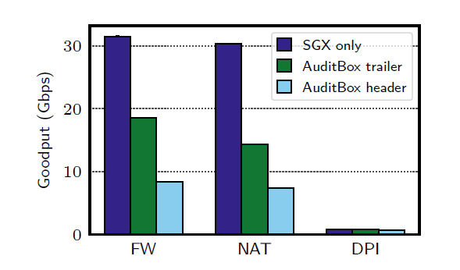
Impact of Optimizations
Header manipulations slow down packet processing and verification, resulting in decrease of goodput by up 2X

Slide 38
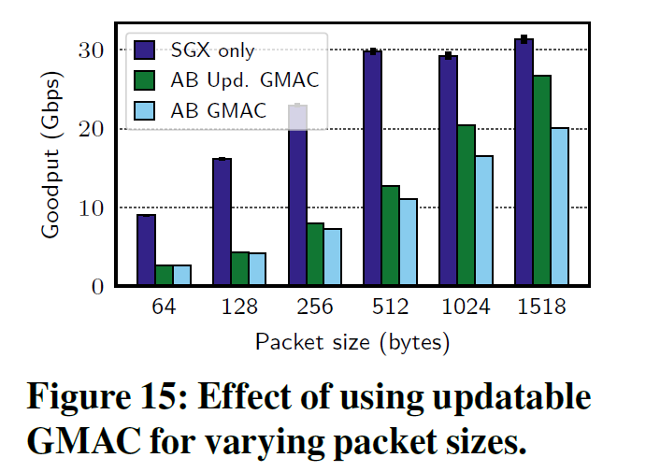
Impact of Optimizations
Updatable GMAC outperforms the regular GMAC by up to 25% for large packets

Slide 39

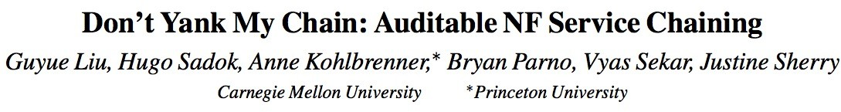
AuditBox Summary
1st NFV auditing system
Leverages trusted execution environments to provide
Runtime correctness guarantees
Offline auditability
And still achieve good performance
Promotes the adoption of NFV for security sensitive enterprises

